Slide 1


SAP OData Training
Day - 9.

Slide 2


Agenda Day - 9
Service Generation Technique
Build OData with SG Technique
Implementing C-R-U-D
Test OData in GW Client
Break
What is RAP ?
Flow of Development (Unmanaged Scenario)
Defining Data Model
Creating OData Service
Trainer: Anubhav Oberoy & Shubham Singh

Slide 3
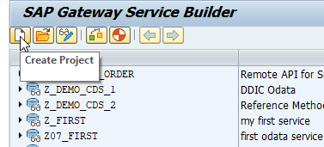
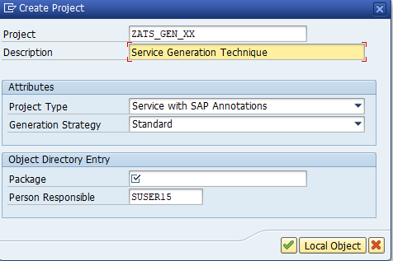
Service Generation Technique
In Service Generation Technique (Mapping Data Source) Create OData Service with Function Model’s or BAPI’S, Go to SEGW and Create Service
Introduction
Step 1. In SEGW Tcode Click On Create Project.
01
Step 2. Assign Project Name and Create OData
Trainer: Anubhav Oberoy & Shubham Singh

Slide 4
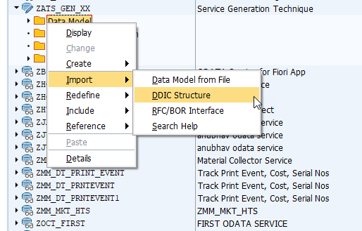
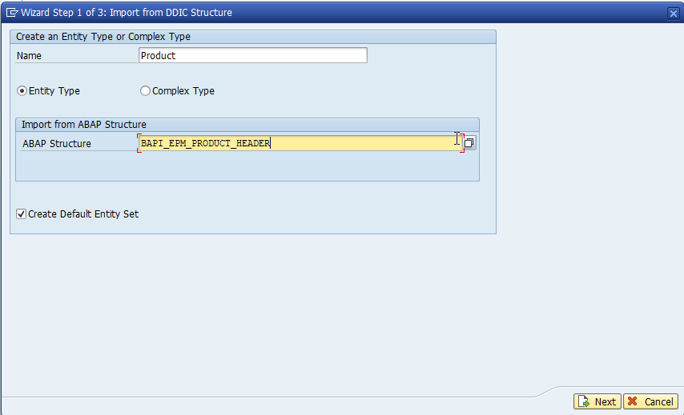
Service Generation Technique
Step 3. Right Click On Data Model and Select DDIC Structure.
Step 4. Give Name of Entity “Product” , Assign ABAP Structure “BAPI_EPM_PRODUCT_HEADER”.
Introduction
01
02
Trainer: Anubhav Oberoy & Shubham Singh

Slide 5
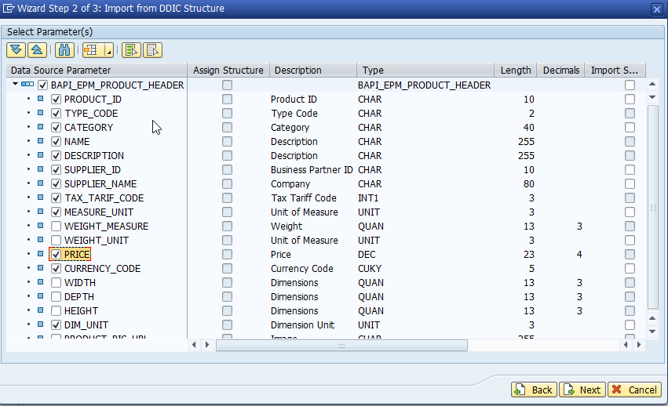
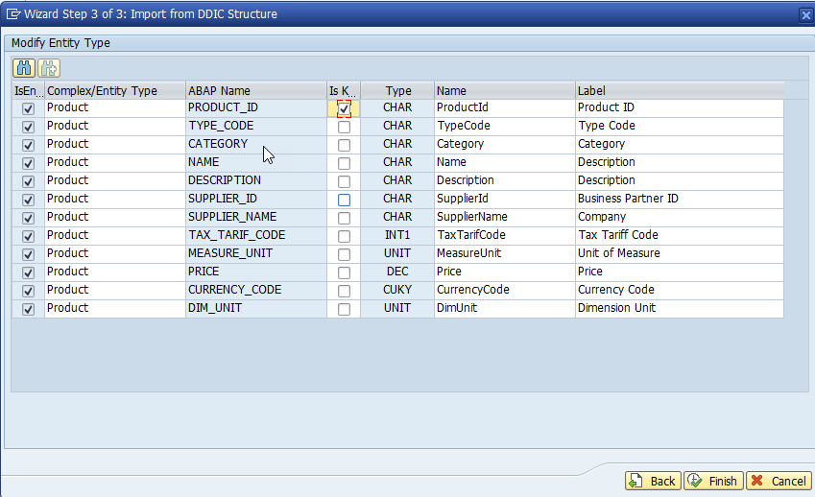
Service Generation Technique
Step 5. Select Fields properties for Entity Type and Click on Next.
Step 6. Select Primary Key and Click On Finish.
Introduction
01
Software Innovation
02
Trainer: Anubhav Oberoy & Shubham Singh

Slide 6
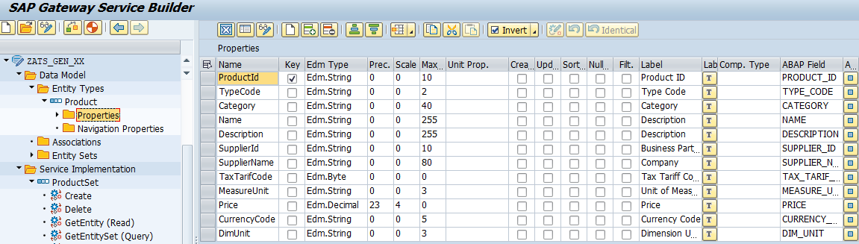
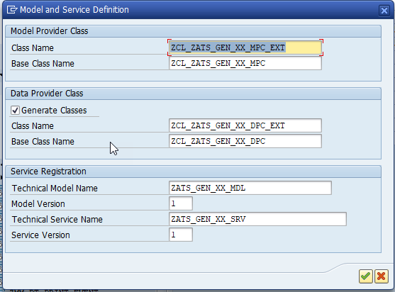
Service Generation Technique
Introduction
Step 7. Generate the Service.
01
02
Trainer: Anubhav Oberoy & Shubham Singh

Slide 7
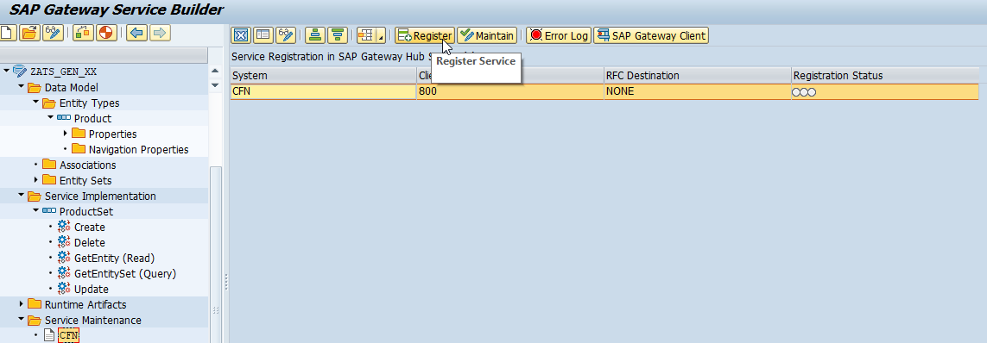
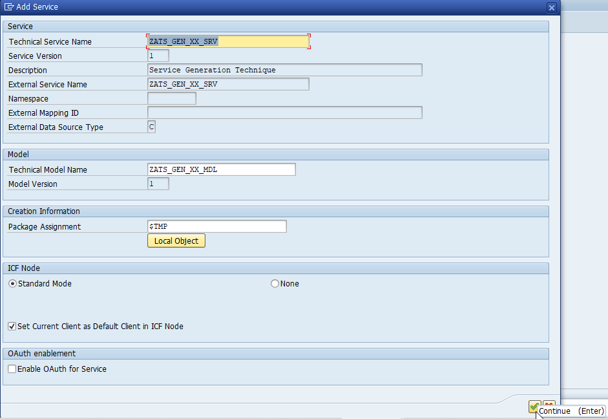
Service Generation Technique
Introduction
Step 8. Go to Service Maintenance Click on Register and Our OData Service is Successfully Registered .
01
Software Innovation
02
Hardware Innovation
Trainer: Anubhav Oberoy & Shubham Singh

Slide 8
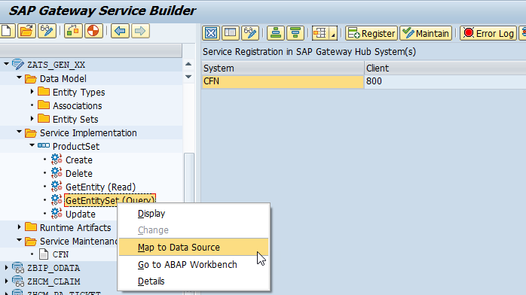
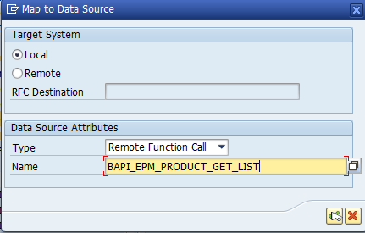
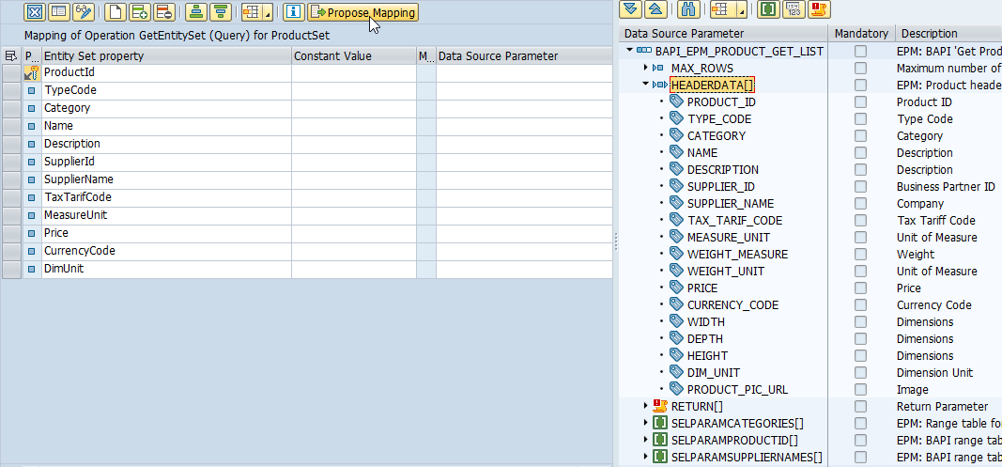
Building Get EntitySet Method
Introduction
01
02
Hardware Innovation
Trainer: Anubhav Oberoy & Shubham Singh

Slide 9
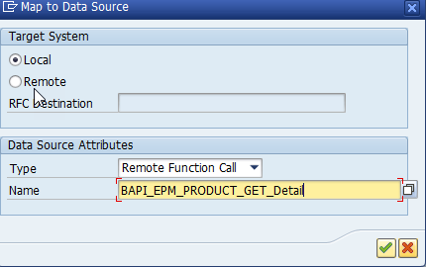
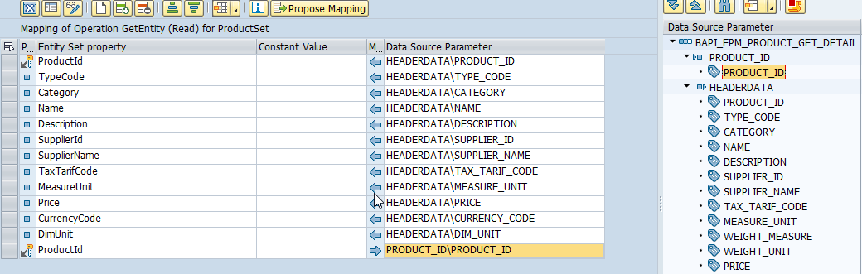
Building Get Entity Method (Single Record )
“BAPI_EPM_PRODUCT_GET_DETAILS” Use for Single Entity.
01
Software Innovation
02
Hardware Innovation
Trainer: Anubhav Oberoy & Shubham Singh

Slide 10
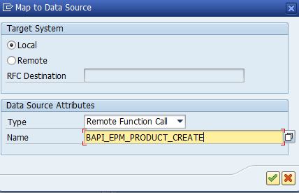
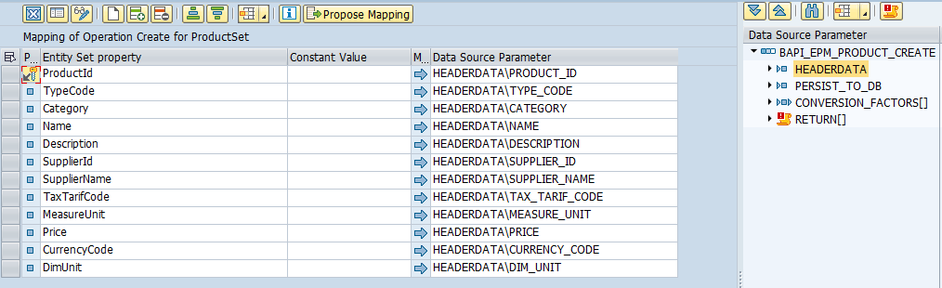
Building Create Entity Method
“BAPI_EPM_PRODUCT_CREATE” Use for Create Record.
01
Software Innovation
02
Hardware Innovation
Trainer: Anubhav Oberoy & Shubham Singh

Slide 11
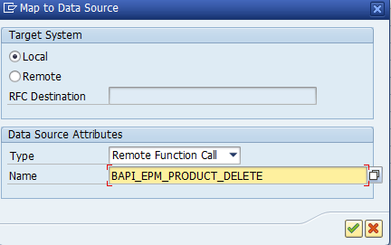
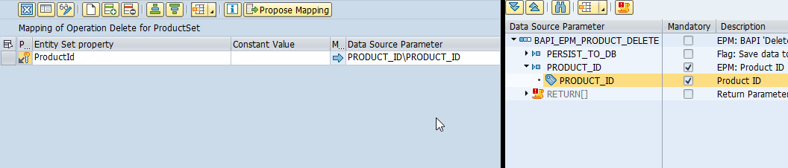
Building DELETE Entity Method
“BAPI_EPM_PRODUCT_DELETE” Use for Delete Record.
Introduction
01
Software Innovation
02
Hardware Innovation
Trainer: Anubhav Oberoy & Shubham Singh

Slide 12
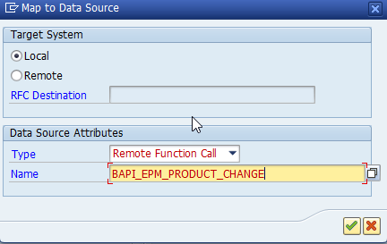
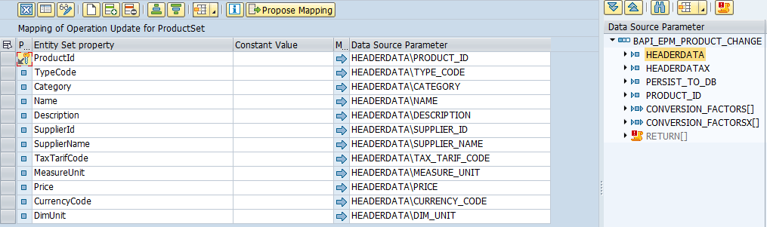
Building UPDATE Entity Method
“BAPI_EPM_PRODUCT_CHANGE” Use for Update Record.
Introduction
01
Software Innovation
02
Hardware Innovation
Trainer: Anubhav Oberoy & Shubham Singh

Slide 13
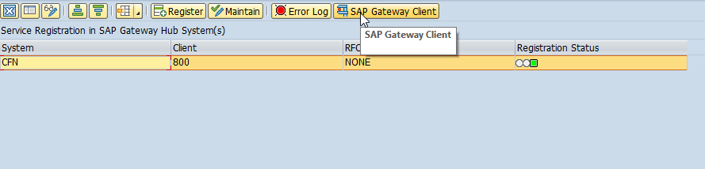
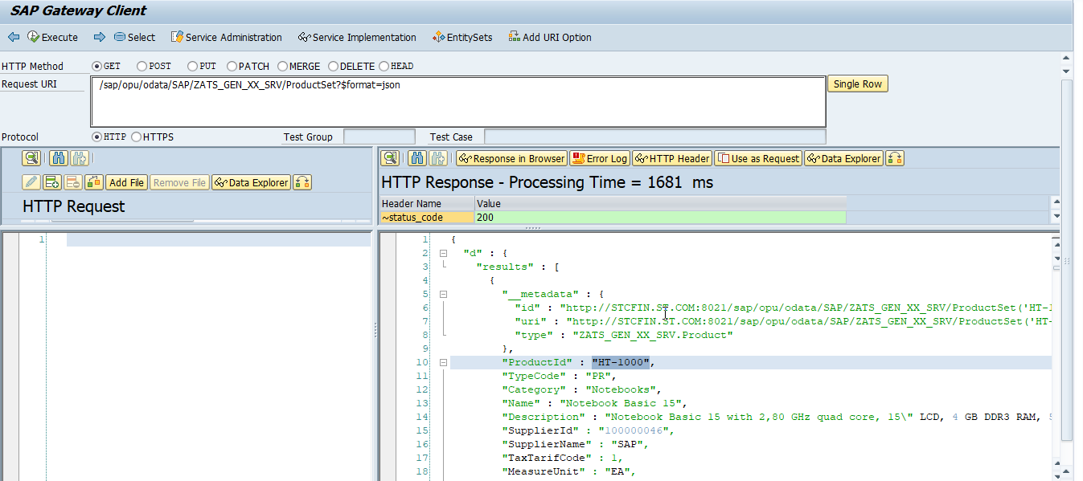
Test OData Service in Gateway Client
Introduction
01
Software Innovation
02
Hardware Innovation
Trainer: Anubhav Oberoy & Shubham Singh

Slide 14

Break

Slide 15

Restful ABAP Programming
The ABAP RESTful programming model defines the architecture for efficient end-to-end development of intrinsically SAP HANA-optimized OData services (such as Fiori apps) in SAP Business Technology Platform ABAP Environment. It supports the development of all types of Fiori applications as well as A2X services. It is based on technologies and frameworks such as Core Data Services (CDS) for defining semantically rich data models and a service model infrastructure for creating OData services with bindings to an OData protocol and ABAP-based application services for custom logic and SAPUI5-based user interfaces .
The whole architecture is based on
CDS views – will helps you to create semantically rich data model
Business Object – here is a node inside a tree data structure which is achieved by using root keyword at CDS view level, this is needed only if we want to add transactional capability.
Finally create a service using service definition and service binding
The binding will confirm the Purpose of service – API or Fiori
UI layer with the Fiori app using elements
01
Software Innovation
02
Trainer: Anubhav Oberoy & Shubham Singh

Slide 16
Important Tables
CDS Views on these table for ease of access
Database tables
Represents entire aviation tourism
/DMO/CARRIER– Contains all the airline codes
I_Currency
CDS view to access currency codes
/DMO/AGENCY
Agent information website/person who helps
/DMO/CONNECTION– FLIGHT infor from origin to destination
I_Country
Country codes
/DMO/TRAVEL
Trip information
01
Software Innovation
/dmo/flight– given flight for diff. dates
/DMO/CUSTOMER
Customer data who willing to book flights
/DMO/BOOKING
Connecting flights in whole travel
02
Hardware Innovation
Trainer: Anubhav Oberoy & Shubham Singh

Slide 17
Flow of Development (Unmanaged Scenario)
Fiori UI
Service Binding for UI
Introduction
Service Definition
01
Travel – Using /demo/travel
Projection view- what we want to show to UI
1
N
I_Currency
1
N
N
Agency
Hardware Innovation
02
Customers
I_Country
Trainer: Anubhav Oberoy & Shubham Singh

Slide 18
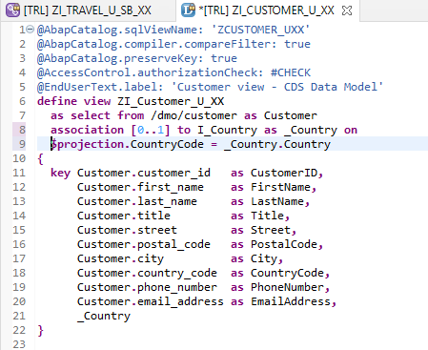
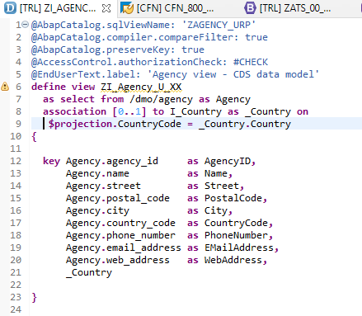
Defining Data Models
Create Customer CDS View “ZI_Customer_U_XX”
Create Customer CDS View “ZI_Agency_U_XX”
Introduction
01
Software Innovation
02
Hardware Innovation
Trainer: Anubhav Oberoy & Shubham Singh

Slide 19
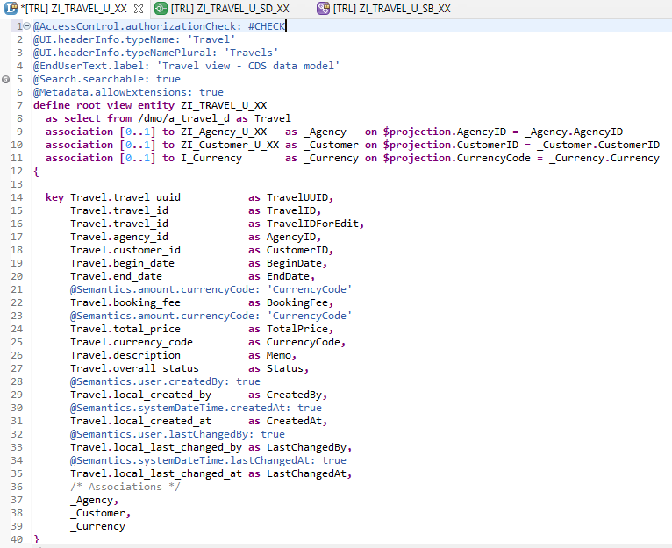
Root CDS Entity
On top of Customer and Agency CDS View we Create Root CDS View Entity called “ZI_TRAVEL_U_XX”.
With Annotations like Metadata ,Search ,
Semantic Annotation etc.
Association to Agency ,Customer , Currency.
Introduction
01
Software Innovation
02
Hardware Innovation
Trainer: Anubhav Oberoy & Shubham Singh

Slide 20
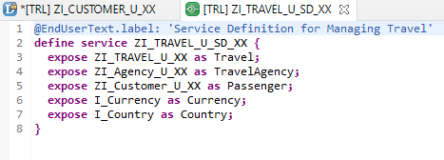
Create OData Service ( Business Service )
A business service definition (short form: service definition) describes which CDS entities of a data model are to be exposed so that a specific business service, for example, Sales Order handling, can be enabled. It is an ABAP Repository object that describes the consumer-specific but protocol-agnostic perspective on a data model. “ZI_TRAVEL_U_SD_XX”
CDS Entity
Service Definition
Service Binding
Introduction
01
02
Hardware Innovation
Trainer: Anubhav Oberoy & Shubham Singh

Slide 21
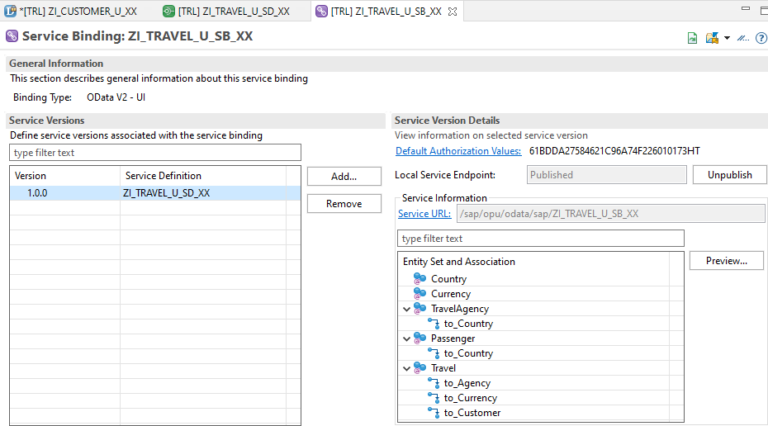
Service Binding ( Business Service )
The business service binding (short form: service binding) is an ABAP Repository object used to bind a service definition to a client-server communication protocol such as OData. Like any other repository object, the service binding uses the proven infrastructure of the ABAP Workbench, including the transport functionality.
01
Software Innovation
02
Hardware Innovation
Trainer: Anubhav Oberoy & Shubham Singh

Slide 22

Questions

Slide 23

ANUBHAV OBEROY
www.anubhavtrainings.com
THANK YOU
“You can never leave footprints that last if you are always walking on tiptoe.”
Notes:
https://pixabay.com/photos/men-employees-suit-work-greeting-1979261/

Slide 24

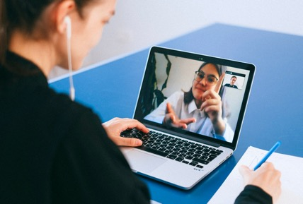
We’re committed to empower you to be
Most Desirable Resource
through powerful training solutions.
We build the workforce of the future.
250+
Corporate Clients
30,000+
Learners Trained
25000+
Learners Placed
FREE WEBINARS
Sign up for free webinars with industry experts every fortnight!
Enroll Now!
Contact us today!
https://anubhavtrainings.com/

Slide 25
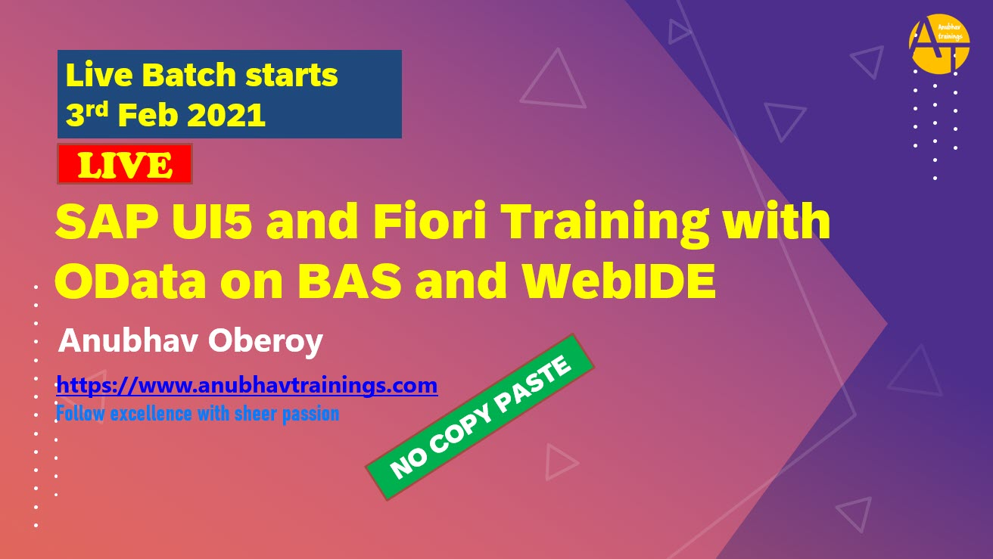


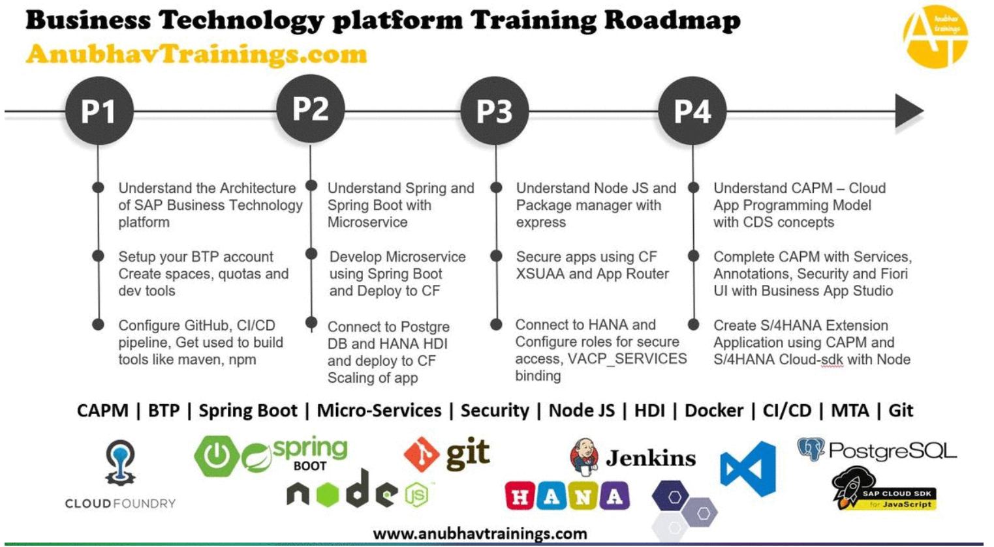
More from AnubhavTrainings.com

